Slide 1

CS 123
DIGITAL LOGIC DESIGN
Spring 2020
Engr. Muhammad Asad Hussain
COUNTERS
Usman Institute of Technology

Slide 2
Counting in Binary
As you know, the binary count sequence follows a familiar pattern of 0’s and 1’s as illustrated in diagram below.
0 0 0
0 0 1
0 1 0
0 1 1
1 0 0
1 0 1
1 1 0
1 1 1
LSB changes on every number.
The next bit changes on every other number.
The next bit changes on every fourth number.
Engr. Muhammad Asad Hussain Usman Institute of Technology

Slide 3
Counting in Binary
A counter can form the same pattern of 0’s and 1’s with logic levels. The first stage in the counter represents the least significant bit – notice that these waveforms follow the same pattern as counting in binary.
LSB
MSB
Engr. Muhammad Asad Hussain Usman Institute of Technology

Slide 4
Counters
As you learned, flip-flops can be connected together to perform counting operations.
Such a group of flip-flops is a counter.
The number of flip-flops used and the way in which they are connected determine the number of states (called the modulus) and also the specific sequence of states.
Engr. Muhammad Asad Hussain Usman Institute of Technology

Slide 5
Counters
Counters are classified into two broad categories
according to the way they are clocked:
Within each of these two categories, counters are classified primarily by the type of sequence, the number of states, or the number of flip-flops in the counter.
Asynchronous
Synchronous
Engr. Muhammad Asad Hussain Usman Institute of Technology

Slide 6
Asynchronous Counters
The term asynchronous refers to events that do not have a fixed time relationship with each other and, generally, do not occur at the same time.
An asynchronous counter is one in which the flip-flops (FF) within the counter do not change states at exactly the same time because they do not have a common clock pulse.
Engr. Muhammad Asad Hussain Usman Institute of Technology

Slide 7
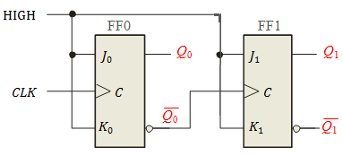
2-Bit Asynchronous Binary Counter
Figure shows a 2-bit counter connected for asynchronous operation.
Notice that the clock (CLK) is applied to the clock input (C) of only the first flip-flop, FF0, which is always the least significant bit (LSB).
The second flip-flop, FF1, is triggered by the Q0 output of FF0.
Engr. Muhammad Asad Hussain Usman Institute of Technology

Slide 8
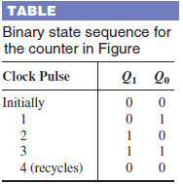

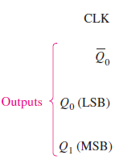

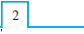
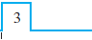
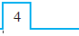



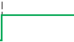








2-Bit Asynchronous Binary Counter
1
0
1
0
1
0
0
0
1
0
1
Engr. Muhammad Asad Hussain Usman Institute of Technology

Slide 9
3-Bit Asynchronous Binary Counter
The state sequence for a 3-bit asynchronous binary counter is same as that of the 2-bit counter except that the 3-bit counter has eight states, due to its three flip-flops.
The counter progresses through a binary count of zero through seven and then recycles to the zero state.
This counter can be easily expanded for higher count, by connecting additional toggle flip-flops.
Engr. Muhammad Asad Hussain Usman Institute of Technology

Slide 10
3-Bit Asynchronous Binary Counter
CLK
Q₀
Q₁
Q₂
Engr. Muhammad Asad Hussain Usman Institute of Technology

Slide 11
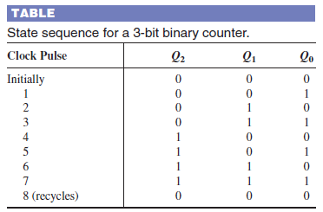
3-Bit Asynchronous Binary Counter
Engr. Muhammad Asad Hussain Usman Institute of Technology

Slide 12
Propagation Delay
Asynchronous counters are commonly referred to as ripple counters for the following reason:
All the stages(FFs) in a counter do not change there states together.
First of all, 1st stage changes its state then the state of next stage changes with respect to the output of 1st stage and so on.
Engr. Muhammad Asad Hussain Usman Institute of Technology

Slide 13
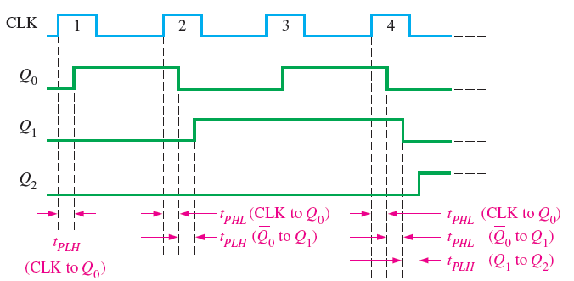
Propagation Delay
To illustrate this concept, consider 3-bit asynchronous binary counter.
All the FFs changes there state on leading-edge of the CLK. This is shown in figure below.
Notice how delays are cumulative as each stage in a counter is clocked later than the previous stage.
Engr. Muhammad Asad Hussain Usman Institute of Technology

Slide 14
Propagation Delay
This cumulative delay of an asynchronous counter is a major disadvantage in many applications because it limits the rate at which the counter can be clocked and creates decoding problems.
The maximum cumulative delay in a counter must be less than the period of the clock waveform.
Engr. Muhammad Asad Hussain Usman Institute of Technology

Slide 15
Counter with negative edge trigger JK flip-flops
Engr. Muhammad Asad Hussain Usman Institute of Technology

Slide 16
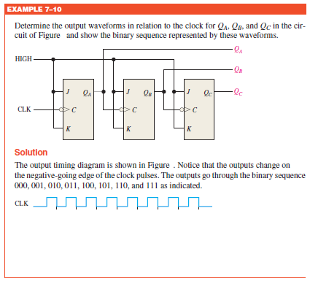
Counting
Engr. Muhammad Asad Hussain Usman Institute of Technology

Slide 17
Asynchronous Decade Counters
The modulus of a counter is the number of unique states through which the counter will sequence.
The maximum possible number of states (maximum modulus) of a counter is 2^{n}, where n is the number of flip-flops in the counter. Counters can be designed to have a number of states in their sequence that is less than the maximum of 2^{n}.
This type of sequence is called a truncated sequence.
Engr. Muhammad Asad Hussain Usman Institute of Technology

Slide 18
Asynchronous Decade Counters
One common modulus for counters with truncated sequences is ten (called MOD10).
Counters with ten states in their sequence are called decade counters.
A decade counter with a count sequence of zero (0000) through nine (1001) is a BCD decade counter because its ten-state sequence produces the BCD code.
Engr. Muhammad Asad Hussain Usman Institute of Technology

Slide 19
Asynchronous Decade Counters
This type of counter is useful in display applications in which BCD is required for conversion to a decimal readout.
To obtain a truncated sequence, it is necessary to force the counter to recycle before going through all of its possible states.
Engr. Muhammad Asad Hussain Usman Institute of Technology

Slide 20
Asynchronous Decade Counters
Let’s use a 4-bit asynchronous counter and modify its sequence to illustrate the principle of truncated counters.
One way to make the counter recycle after the count of nine (1001) is to decode count ten (1010) with a NAND gate and connect the output of the NAND gate to the clear (CLR) inputs of the flip-flops, as shown in Figure.
Engr. Muhammad Asad Hussain Usman Institute of Technology

Slide 21
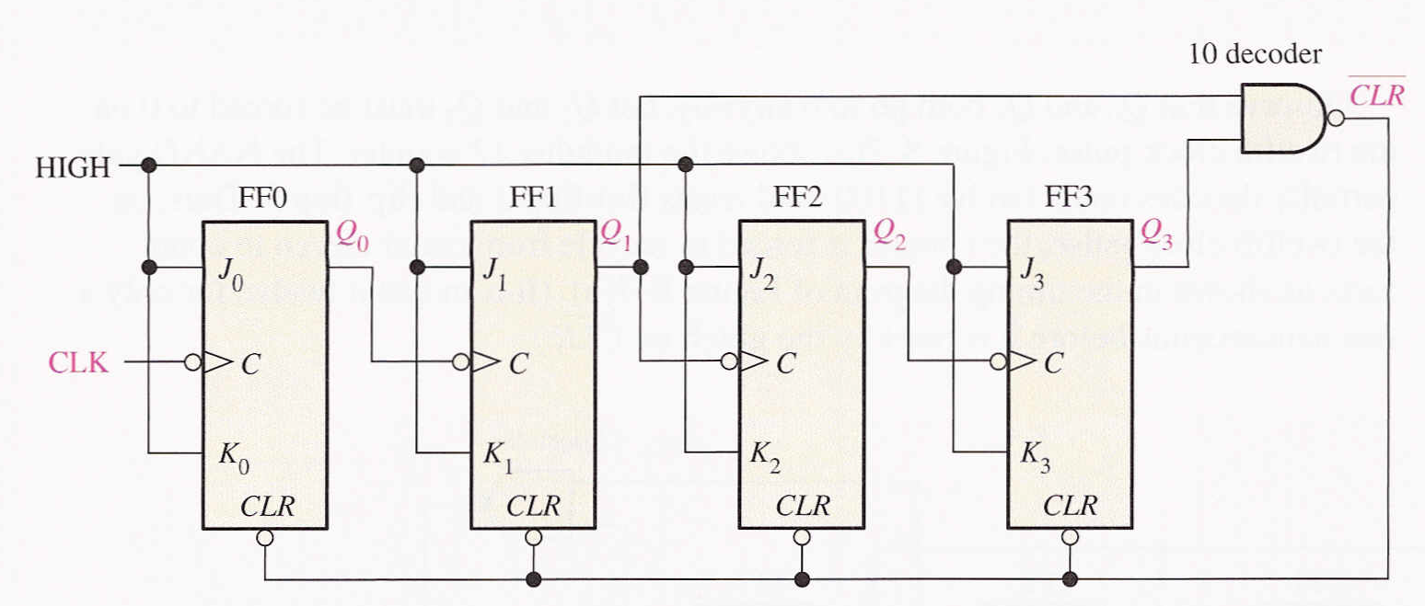
Asynchronous Decade Counters
Engr. Muhammad Asad Hussain Usman Institute of Technology

Slide 22
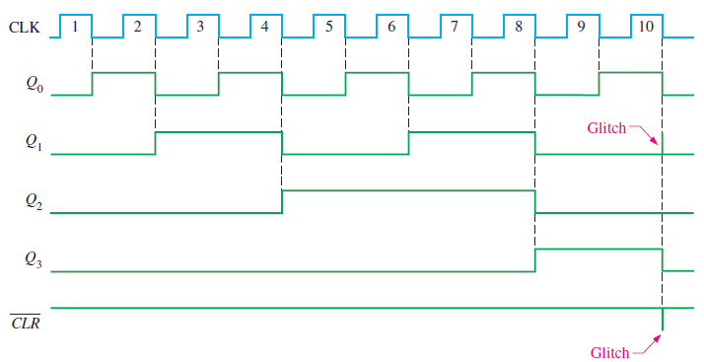
Asynchronous Decade Counters
Engr. Muhammad Asad Hussain Usman Institute of Technology

Slide 23
Partial Decoding
Notice in decade counter that only Q1 and Q3 are connected to the NAND gate inputs.
This arrangement is an example of partial decoding, in which the two unique states (Q1 = 1 and Q3 = 1) are sufficient to decode the count of ten.
When the counter goes into count ten (1010), the decoding gate output goes LOW and asynchronously resets all the flip-flops.
Other truncated sequences can be implemented in a similar way
Engr. Muhammad Asad Hussain Usman Institute of Technology

Slide 24
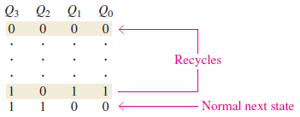
Partial Decoding
Since three flip-flops can produce a maximum of eight states, four flip-flops are required to produce any modulus greater than eight but less than or equal to sixteen.
When the counter gets to its last state, 1011, it must recycle back to 0000 rather than going to its normal next state of 1100, as illustrated in the following sequence chart:
Engr. Muhammad Asad Hussain Usman Institute of Technology

Slide 25
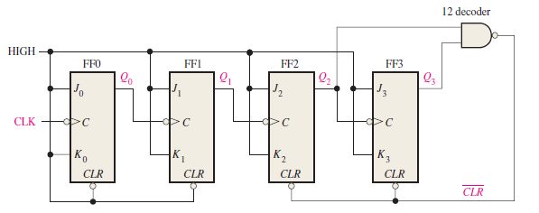
Partial Decoding
MOD 12 Counter
Engr. Muhammad Asad Hussain Usman Institute of Technology

Slide 26
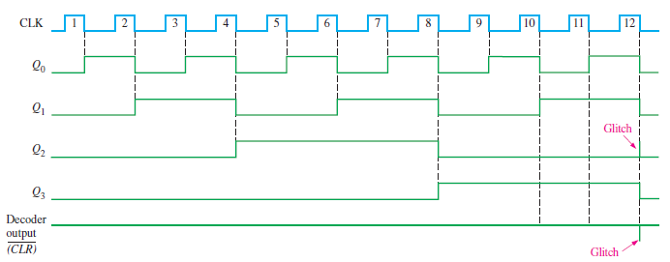
Partial Decoding
Engr. Muhammad Asad Hussain Usman Institute of Technology

Slide 27
Synchronous Counters
In a synchronous counter all flip-flops are clocked together with a common clock pulse. Synchronous counters overcome the disadvantage of accumulated propagation delays, but generally they require more circuitry to control states changes.
This 3-bit binary synchronous counter has the same count sequence as the 3-bit asynchronous counter shown previously.
HIGH
Q₀
Q₀
Q₁
Q₀Q₁
Q₂
J₀
J₁
J₂
C
C
C
K₀
K₁
K₂
CLK
The next slide shows how to analyze this counter by writing the logic equations for each input. Notice the inputs to each flip-flop…
Engr. Muhammad Asad Hussain Usman Institute of Technology

Slide 28
Analysis of Synchronous Counters
A tabular technique for analysis is illustrated for the counter on the previous slide. Start by setting up the outputs as shown, then write the logic equation for each input. This has been done for the counter.
1. Put the counter in an arbitrary state; then determine the inputs for this state.
2. Use the new inputs to determine the next state: Q₂ and Q₁ will latch and Q₀ will toggle.
3. Set up the next group of inputs from the current output.
Outputs
Logic for inputs
Q₂ Q₁ Q₀ | J₂ = Q₀Q₁ | K₂ = Q₀Q₁ | J₁ = Q₀ | K₁ = Q₀ | J₀ = 1 | K₀ = 1
0 0 0
0
0
0
0
1
1
0 0 1
0
0
1
1
1
1
0 1 0
4. Q₂ will latch again but both Q₁ and Q₀ will toggle.
Continue like this, to complete the table. The next slide shows the completed table…
Engr. Muhammad Asad Hussain Usman Institute of Technology

Slide 29
Analysis of Synchronous Counters
Outputs
Logic for inputs
Q₂ Q₁ Q₀ | J₂ = Q₀Q₁ | K₂ = Q₀Q₁ | J₁ = Q₀ | K₁ = Q₀ | J₀ = 1 | K₀ = 1
0 0 0
0
0
0
0
1
1
0 0 1
0
0
1
1
1
1
0 1 0
0
0
0
0
1
1
0 1 1
1
1
1
1
1
1
1 0 0
0
0
0
0
1
1
1 0 1
0
0
1
1
1
1
1 1 0
0
0
0
0
1
1
1 1 1
1
1
1
1
1
1
0 0 0
At this points all states have been accounted for and the counter is ready to recycle…
Engr. Muhammad Asad Hussain Usman Institute of Technology

Slide 30
Gray Code
The Gray code is unweighted and is not an arithmetic code;
That is, there are no specific weights assigned to the bit positions.
The important feature of the Gray code is that it
exhibits only a single bit change from one code word to the next in sequence.
Engr. Muhammad Asad Hussain Usman Institute of Technology

Slide 31
Gray Code
This property is important in many applications, such as shaft position encoders, where error susceptibility increases with the number of bit changes between adjacent numbers in a sequence.
Engr. Muhammad Asad Hussain Usman Institute of Technology

Slide 32
Gray Code
The circuit below shows how binary numbers are converted in gray codes.
Engr. Muhammad Asad Hussain Usman Institute of Technology

Slide 33
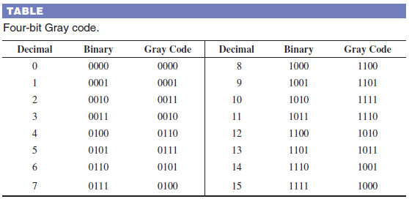
Gray Code
Table below shows listing of the 4-bit Gray code for decimal numbers 0 through 15.
Binary numbers are shown in the table for reference.
Engr. Muhammad Asad Hussain Usman Institute of Technology

Slide 34
Finite State Machine
A state machine is a sequential circuit having a limited (finite) number of states occurring in a prescribed order.
A counter is an example of a state machine; the number of states is called the modulus.
Two basic types of state machines are:
Moore State Machine
Mealy State Machine
State Machine
Engr. Muhammad Asad Hussain Usman Institute of Technology

Slide 35
Moore State Machine
Moore state machine is one where the outputs depend only on the internal present state.
In the Moore machine, the combinational logic is a gate array with outputs that determine the next state of the flip-flops in the memory.
Input(s) does not affect the outputs because they always correspond to and are dependent only on the present state of the memory.
Engr. Muhammad Asad Hussain Usman Institute of Technology

Slide 36
Moore State Machine
Engr. Muhammad Asad Hussain Usman Institute of Technology

Slide 37
Example of Moore State Machine
Figure shows a Moore machine (modulus-26 binary counter with states 0 through 25) that is used to control the number of tablets (25) that go into each bottle in an assembly line.
Engr. Muhammad Asad Hussain Usman Institute of Technology

Slide 38
Example of Moore State Machine
There is no input in this case, other than the clock, so the next state is determined only by the present state, which makes this a Moore machine.
Engr. Muhammad Asad Hussain Usman Institute of Technology

Slide 39
Mealy State Machine
The Mealy state machine is one where the outputs depend on both the internal present state and on the inputs.
For the Mealy machine, the present state affects the outputs, just as in the Moore machine; but in addition, the inputs also affect the outputs.
The outputs come directly from the combinational logic and not the memory.
Engr. Muhammad Asad Hussain Usman Institute of Technology

Slide 40
Mealy State Machine
Engr. Muhammad Asad Hussain Usman Institute of Technology

Slide 41
Example of Mealy State Machine
Figure shows the tablet-bottling system that uses three different sizes of bottles: a 25-tablet bottle, a 50-tablet bottle, and a 100-tablet bottle.
This operation requires a state machine with three different terminal counts: 25, 50, and 100.
Engr. Muhammad Asad Hussain Usman Institute of Technology

Slide 42
Example of Mealy State Machine
The combinational logic sets the modulus of the counter depending on the modulus-select inputs.
The output of the counter depends on both the present state and the modulus-select inputs, making this a Mealy machine.
Engr. Muhammad Asad Hussain Usman Institute of Technology

Slide 43
Design of Sequential Circuit
The steps in designing any sequential circuit are given below:
Step # 1: State Diagram
Step # 2: Next-State Table
Step # 3: Flip-Flop Transition Table
Step # 4: Karnaugh Maps
Step # 5: Logic Expressions for Flip-Flop Inputs
Step # 6: Circuit Implementation.
Engr. Muhammad Asad Hussain Usman Institute of Technology

Slide 44
Step # 1: State Diagram
Specify the output sequence and draw a state diagram.
Step # 2: Next-State Table
Derive a next-state table from the state diagram.
Step # 3: Flip-Flop Transition Table
Develop a transition table showing the flip-flop inputs required for each transition.
Engr. Muhammad Asad Hussain Usman Institute of Technology

Slide 45
Step # 4: Karnaugh Maps
Transfer the input states of Flip-Flop from the transition table to Karnaugh maps.
Step # 5: Logic Expression for Flip-Flop Inputs
Group the Karnaugh map cells to generate and derive the logic expression for each flip-flop input.
Step # 6: Circuit Implementation
Implement the expression with combinational logic, and combine with the flip-flops to create the logic circuit.
Engr. Muhammad Asad Hussain Usman Institute of Technology

Slide 46
Design of 3-bit Gray code counter
Step # 1: State Diagram
000
100
001
101
011
111
010
110
Engr. Muhammad Asad Hussain Usman Institute of Technology

Slide 47









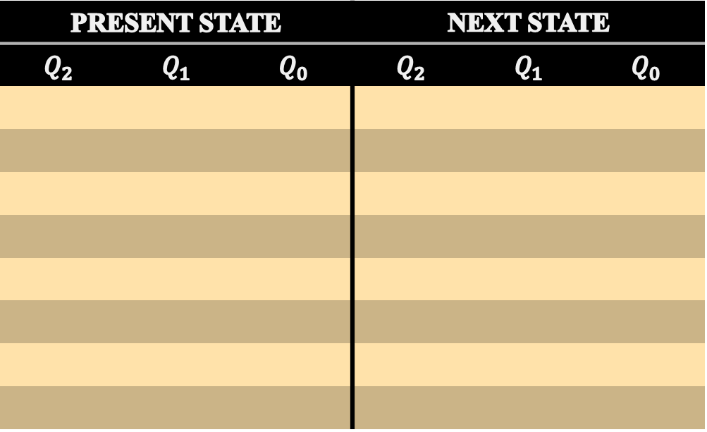
Design of 3-bit Gray code counter
Step # 2: Next-State Table
PRESENT STATE |  |  | NEXT STATE
$$Q_{2}$$ | $$Q_{1}$$ | $$Q_{0}$$ | $$Q_{2}$$ | $$Q_{1}$$ | $$Q_{0}$$
0
0
0
0
0
1
0
0
1
0
1
1
0
1
1
0
1
0
0
1
0
1
1
0
1
1
0
1
1
1
1
1
1
1
0
1
1
0
1
1
0
0
1
0
0
0
0
0
Engr. Muhammad Asad Hussain Usman Institute of Technology

Slide 48
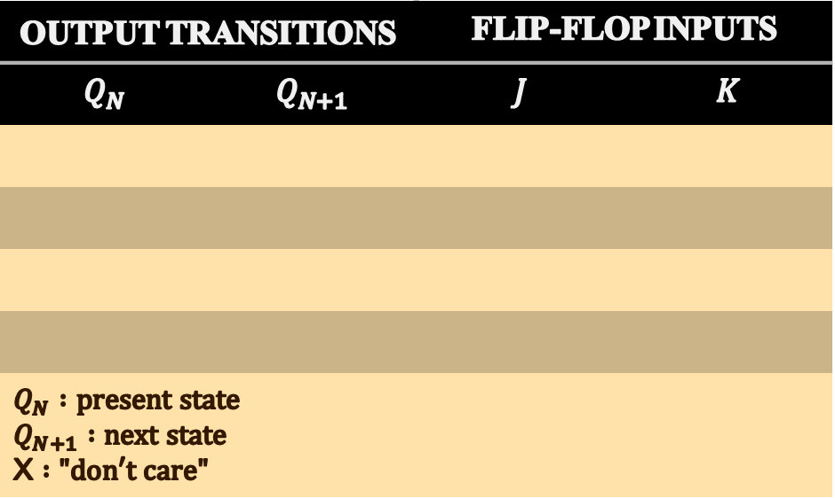
Step # 3: Flip-Flop Transition Table
OUTPUT TRANSITIONS |  | FLIP-FLOP INPUTS
$$Q_{N}$$ | $$Q_{N+1}$$ | $$J$$ | $$K$$
$$Q_{N} :present state$$ $$Q_{N+1} :next state$$ X $:"don′t care"$
0
0
0
X
0
1
1
X
1
0
X
1
1
1
X
0
Engr. Muhammad Asad Hussain Usman Institute of Technology

Slide 49
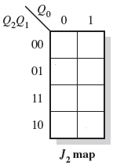
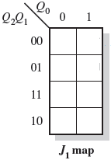
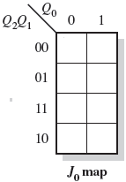
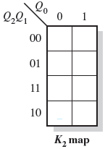
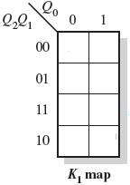
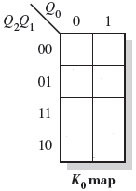
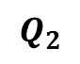
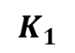
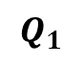
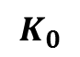
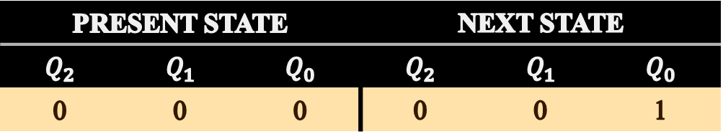
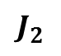
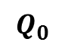
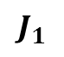
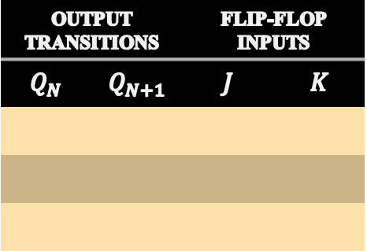
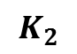
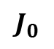
Step # 4: Karnaugh Maps
PRESENT STATE |  |  | NEXT STATE
$$Q_{2}$$ | $$Q_{1}$$ | $$Q_{0}$$ | $$Q_{2}$$ | $$Q_{1}$$ | $$Q_{0}$$
0 | 0 | 0 | 0 | 0 | 1
0
0
1
OUTPUT TRANSITIONS |  | FLIP-FLOP INPUTS
$$Q_{N}$$ | $$Q_{N+1}$$ | $$J$$ | $$K$$
$$Q_{0}$$
0
1
$$J_{0}$$
1
$$K_{0}$$
X
X
X
X
$$Q_{1}$$
0
0
$$J_{1}$$
0
$$K_{1}$$
X
$$Q_{2}$$
0
0
$$J_{2}$$
0
$$K_{2}$$
X
Engr. Muhammad Asad Hussain Usman Institute of Technology

Slide 50
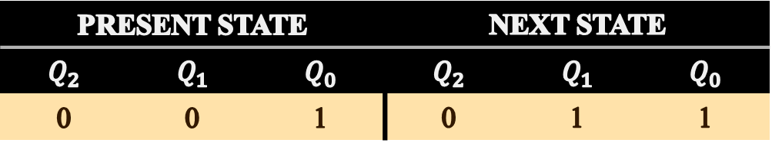
Step # 4: Karnaugh Maps (Cont..)
PRESENT STATE |  |  | NEXT STATE
$$Q_{2}$$ | $$Q_{1}$$ | $$Q_{0}$$ | $$Q_{2}$$ | $$Q_{1}$$ | $$Q_{0}$$
0 | 0 | 1 | 0 | 1 | 1
0
1
X
OUTPUT TRANSITIONS |  | FLIP-FLOP INPUTS
$$Q_{N}$$ | $$Q_{N+1}$$ | $$J$$ | $$K$$
$$Q_{0}$$
1
1
$$J_{0}$$
X
$$K_{0}$$
0
X
X
0
$$Q_{1}$$
0
1
$$J_{1}$$
1
$$K_{1}$$
X
$$Q_{2}$$
0
0
$$J_{2}$$
0
$$K_{2}$$
X
Engr. Muhammad Asad Hussain Usman Institute of Technology

Slide 51
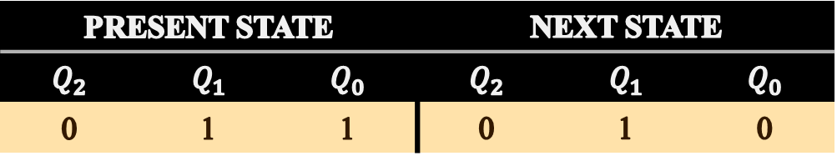
Step # 4: Karnaugh Maps (Cont..)
PRESENT STATE |  |  | NEXT STATE
$$Q_{2}$$ | $$Q_{1}$$ | $$Q_{0}$$ | $$Q_{2}$$ | $$Q_{1}$$ | $$Q_{0}$$
0 | 1 | 1 | 0 | 1 | 0
0
X
X
OUTPUT TRANSITIONS |  | FLIP-FLOP INPUTS
$$Q_{N}$$ | $$Q_{N+1}$$ | $$J$$ | $$K$$
$$Q_{0}$$
1
0
$$J_{0}$$
X
$$K_{0}$$
1
$$Q_{1}$$
1
1
$$J_{1}$$
X
$$K_{1}$$
0
X
0
1
$$Q_{2}$$
0
0
$$J_{2}$$
0
$$K_{2}$$
X
Engr. Muhammad Asad Hussain Usman Institute of Technology

Slide 52
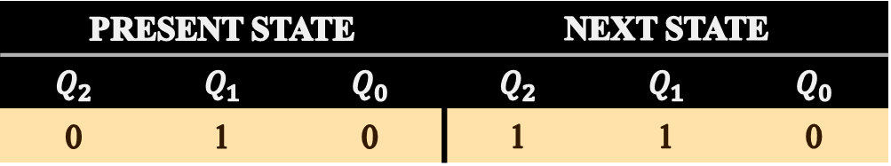
Step # 4: Karnaugh Maps (Cont..)
PRESENT STATE |  |  | NEXT STATE
$$Q_{2}$$ | $$Q_{1}$$ | $$Q_{0}$$ | $$Q_{2}$$ | $$Q_{1}$$ | $$Q_{0}$$
0 | 1 | 0 | 1 | 1 | 0
1
X
0
OUTPUT TRANSITIONS |  | FLIP-FLOP INPUTS
$$Q_{N}$$ | $$Q_{N+1}$$ | $$J$$ | $$K$$
$$Q_{0}$$
0
0
$$J_{0}$$
0
$$K_{0}$$
X
$$Q_{1}$$
1
1
$$J_{1}$$
X
$$K_{1}$$
0
X
0
X
$$Q_{2}$$
0
1
$$J_{2}$$
1
$$K_{2}$$
X
Engr. Muhammad Asad Hussain Usman Institute of Technology

Slide 53
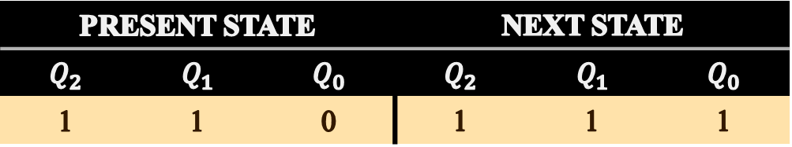
Step # 4: Karnaugh Maps (Cont..)
PRESENT STATE |  |  | NEXT STATE
$$Q_{2}$$ | $$Q_{1}$$ | $$Q_{0}$$ | $$Q_{2}$$ | $$Q_{1}$$ | $$Q_{0}$$
1 | 1 | 0 | 1 | 1 | 1
X
X
1
OUTPUT TRANSITIONS |  | FLIP-FLOP INPUTS
$$Q_{N}$$ | $$Q_{N+1}$$ | $$J$$ | $$K$$
$$Q_{0}$$
0
1
$$J_{0}$$
1
$$K_{0}$$
X
$$Q_{1}$$
1
1
$$J_{1}$$
X
$$K_{1}$$
0
$$Q_{2}$$
1
1
$$J_{2}$$
X
$$K_{2}$$
0
0
0
X
Engr. Muhammad Asad Hussain Usman Institute of Technology

Slide 54
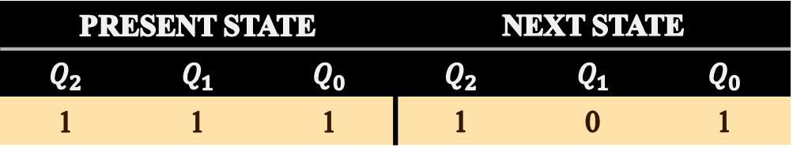
Step # 4: Karnaugh Maps (Cont..)
PRESENT STATE |  |  | NEXT STATE
$$Q_{2}$$ | $$Q_{1}$$ | $$Q_{0}$$ | $$Q_{2}$$ | $$Q_{1}$$ | $$Q_{0}$$
1 | 1 | 1 | 1 | 0 | 1
X
X
X
OUTPUT TRANSITIONS |  | FLIP-FLOP INPUTS
$$Q_{N}$$ | $$Q_{N+1}$$ | $$J$$ | $$K$$
$$Q_{0}$$
1
1
$$J_{0}$$
X
$$K_{0}$$
0
$$Q_{1}$$
1
0
$$J_{1}$$
X
$$K_{1}$$
1
$$Q_{2}$$
1
1
$$J_{2}$$
X
$$K_{2}$$
0
0
1
0
Engr. Muhammad Asad Hussain Usman Institute of Technology

Slide 55
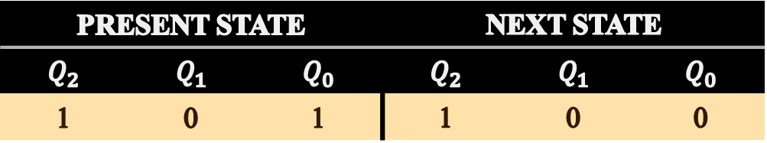
Step # 4: Karnaugh Maps (Cont..)
PRESENT STATE |  |  | NEXT STATE
$$Q_{2}$$ | $$Q_{1}$$ | $$Q_{0}$$ | $$Q_{2}$$ | $$Q_{1}$$ | $$Q_{0}$$
1 | 0 | 1 | 1 | 0 | 0
OUTPUT TRANSITIONS |  | FLIP-FLOP INPUTS
$$Q_{N}$$ | $$Q_{N+1}$$ | $$J$$ | $$K$$
X
0
X
$$Q_{0}$$
1
0
$$J_{0}$$
X
$$K_{0}$$
1
$$Q_{1}$$
0
0
$$J_{1}$$
0
$$K_{1}$$
X
$$Q_{2}$$
1
1
$$J_{2}$$
X
$$K_{2}$$
0
0
X
1
Engr. Muhammad Asad Hussain Usman Institute of Technology

Slide 56
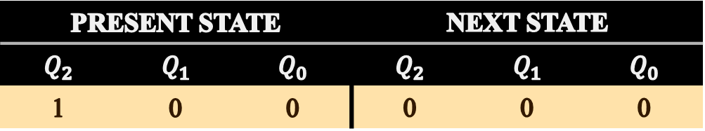
Step # 4: Karnaugh Maps (Cont..)
PRESENT STATE |  |  | NEXT STATE
$$Q_{2}$$ | $$Q_{1}$$ | $$Q_{0}$$ | $$Q_{2}$$ | $$Q_{1}$$ | $$Q_{0}$$
1 | 0 | 0 | 0 | 0 | 0
OUTPUT TRANSITIONS |  | FLIP-FLOP INPUTS
$$Q_{N}$$ | $$Q_{N+1}$$ | $$J$$ | $$K$$
X
0
0
$$Q_{0}$$
0
0
$$J_{0}$$
0
$$K_{0}$$
X
$$Q_{1}$$
0
0
$$J_{1}$$
0
$$K_{1}$$
X
$$Q_{2}$$
1
0
$$J_{2}$$
X
$$K_{2}$$
X
1
X
X
Engr. Muhammad Asad Hussain Usman Institute of Technology

Slide 57
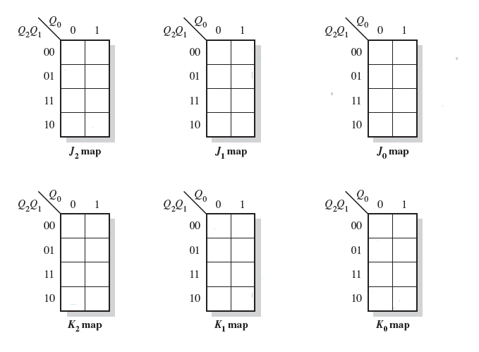
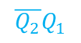
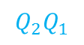
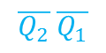
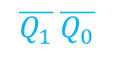
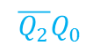
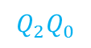
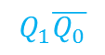

Step # 4: Karnaugh Maps (Cont..)
0
0
0
1
$$\overline{Q_{2}}Q_{0}$$
1
X
$$\overline{Q_{2}} \overline{Q_{1}}$$
1
0
X
X
0
X
X
X
X
X
1
X
$$Q_{2}Q_{1}$$
$$Q_{1}\overline{Q_{0}}$$
X
X
0
0
0
X
X
X
X
X
X
0
X
X
0
0
X
1
$$\overline{Q_{2}}Q_{1}$$
0
0
0
1
$$Q_{2}Q_{0}$$
X
0
1
0
X
X
X
1
$$Q_{2}\overline{Q_{1}}$$
$$\overline{Q_{1}} \overline{Q_{0}}$$
Engr. Muhammad Asad Hussain Usman Institute of Technology

Slide 58

Step # 5: Logic Expressions for Flip-Flop Inputs
From Karnaugh Maps, the following expressions for the J and K inputs of each flip-flop are obtained:
$$J_{0}=Q_{2}Q_{1}+\overline{Q_{2}} \overline{Q_{1}}=\overline{Q_{2}⊕Q_{1}}$$
$$K_{0}=Q_{2}\overline{Q_{1}}+\overline{Q_{2}}Q_{1} =Q_{2}⊕Q_{1}$$
$$J_{1}=Q_{2}\overline{Q_{0}}$$
$$K_{1}=Q_{2}Q_{0}$$
$$J_{2}=Q_{1}\overline{Q_{0}}$$
$$K_{2}=\overline{Q_{1}} \overline{Q_{0}}$$
Engr. Muhammad Asad Hussain Usman Institute of Technology

Slide 59
Step # 6: Counter Implementation
Engr. Muhammad Asad Hussain Usman Institute of Technology

Slide 60

Example
Engr. Muhammad Asad Hussain Usman Institute of Technology

Slide 61
Example
Engr. Muhammad Asad Hussain Usman Institute of Technology

Slide 62
Example
Engr. Muhammad Asad Hussain Usman Institute of Technology

Slide 63
Example
Engr. Muhammad Asad Hussain Usman Institute of Technology

Slide 64
Example
Engr. Muhammad Asad Hussain Usman Institute of Technology

Slide 65
Example
Engr. Muhammad Asad Hussain Usman Institute of Technology

Slide 66

Example

Slide 67


Example

Slide 68

Example

Slide 69

Example

Slide 70

Example

Slide 71

Example

